Slide 1
Connected Field Service
Device Registration & Twins

Slide 2
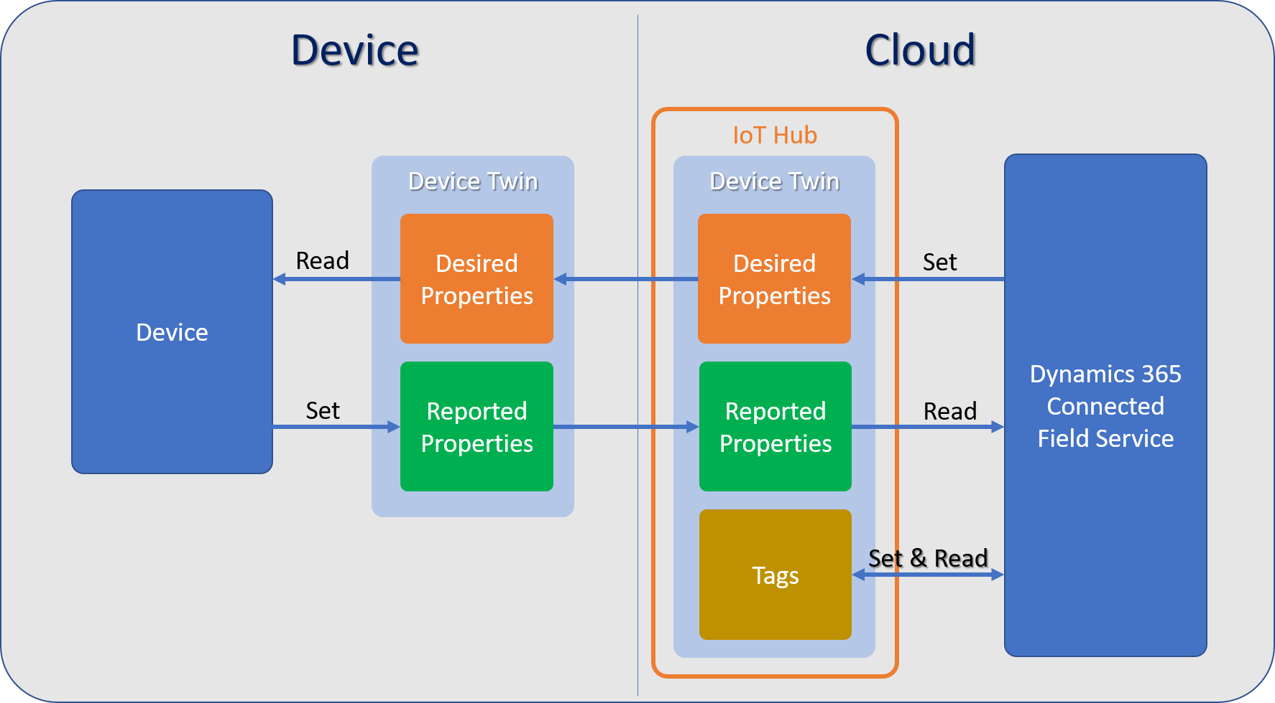
Device Twins & Connected Field Service

